Slide 1
Week 3 Lecture
STA10003 FOUNDATIONS OF STATISTICS
Jascha Zimmermann
jzimmermann@swin.edu.au
Notes:
Need song for this week!
https://www.youtube.com/watch?v=37Qsqd8mw9o
Cold Chisel! – 1980 -ITA
Put up until recording starts …
In each lecture, we will do a brief revision of what we talked about last week.
But before we do that …

Slide 2



Indigenous Acknowledgment
Swinburne University of Technology recognises the historical and cultural significance of Australia’s Indigenous history and the role it plays in contemporary education.
Each day, every Australian walks on what was once traditional Indigenous land. I acknowledge the traditional custodians of the land I currently occupy, the Wurundjeri people.
We acknowledge and respect the Traditional Owners of all the lands across Australia, their cultures and heritages. We pay our respects to the Ancestors, Elders past, present and emerging. We recognise the continuing sovereignties of all Aboriginal and Torres Strait Islander Nations.
Notes:
"In recognising the importance of education, Swinburne University also recognises the importance of Australia's Indigenous history and culture to our every day lives. As such, an acknowledgment of traditional custodians is a relevant and important way to connect to that history and culture”.

Slide 3
Overview
Revision of Week 2
Variability Range, Variance, Standard deviation
PAUSE – Part 2
Reporting on a distribution
Categorical: Most typical and any other interesting information
Metric: shape / centre / spread / outliers
Notes:
Firstly, we’ll look at report writing for both Categorical and Metric variables.
We make some decisions about what figures we need to include – and interpret.
We’ll also look at the difference between a Research Question and an Hypothesis, and we’ll finish up with the first part of testing for Significance ...

Slide 4
Part 1: Week 2 Revision & Variability
STA10003 Week 3

Slide 5
Revision of Week 2
Levels of Measurement of Variables:
Categorical:
Numbers are arbitrary and used as codes
0 = Sedentary, 1 = Low, 2 = Moderate, 3 = High
41 = Sedentary, 35 = Low, 30 = Moderate, 9 = High
Metric:
Numbers mean something real
eg 55 years of age, number of serves of vegetables per day
Some variables can be measured as either Categorical or Metric – so always check!
Income in $ [metric]
Income as high, medium, low [categorical]
Notes:
Last week, we talked about the different levels of measurement of variables. In this Unit, we make the distinction between Categorical and Metric variables.
Because SPSS can only deal with numbers, we need to remind ourselves that the numbers used for Categorical variables are purely arbitrary and are used to code our variable.
Metric data, on the other hand, uses numbers to actually mean something real.
Some variables can either be Categorical and / or Metric variables, such as Income in $ as metric, and Income in Socio-Economic Status as Categorical. So we need to always check how the variables are coded, rather than making assumptions as this can impact on the type of analysis we can do ...

Slide 6
Revision of Week 2
SPSS Output
Categorical variables:
Frequency Table
Bar Chart
Which procedure? FREQUENCIES
Notes:
What output we can produce depends on the level of measurement of the variable.
We used the Frequencies procedure for our Categorical variable to get our Frequency Table and a Bar Chart.
When quoting figures, we take our percentages from the VALID percent column. We’re only interested in talking about the people that actually answered the question ...

Slide 7
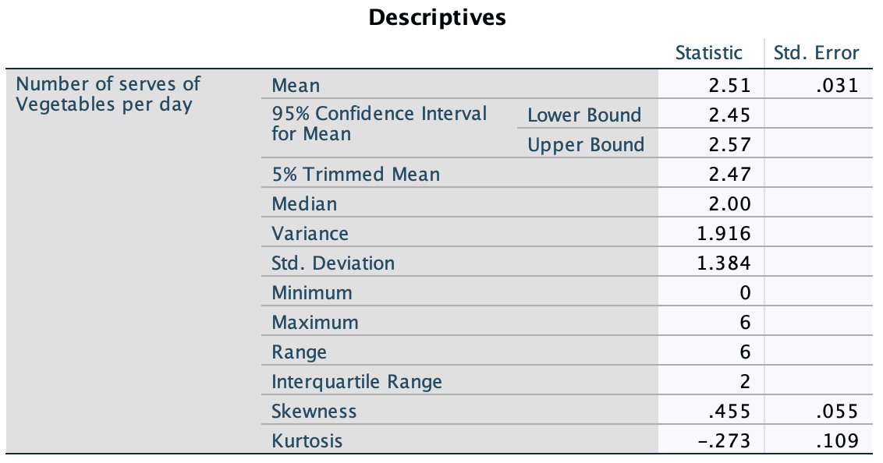
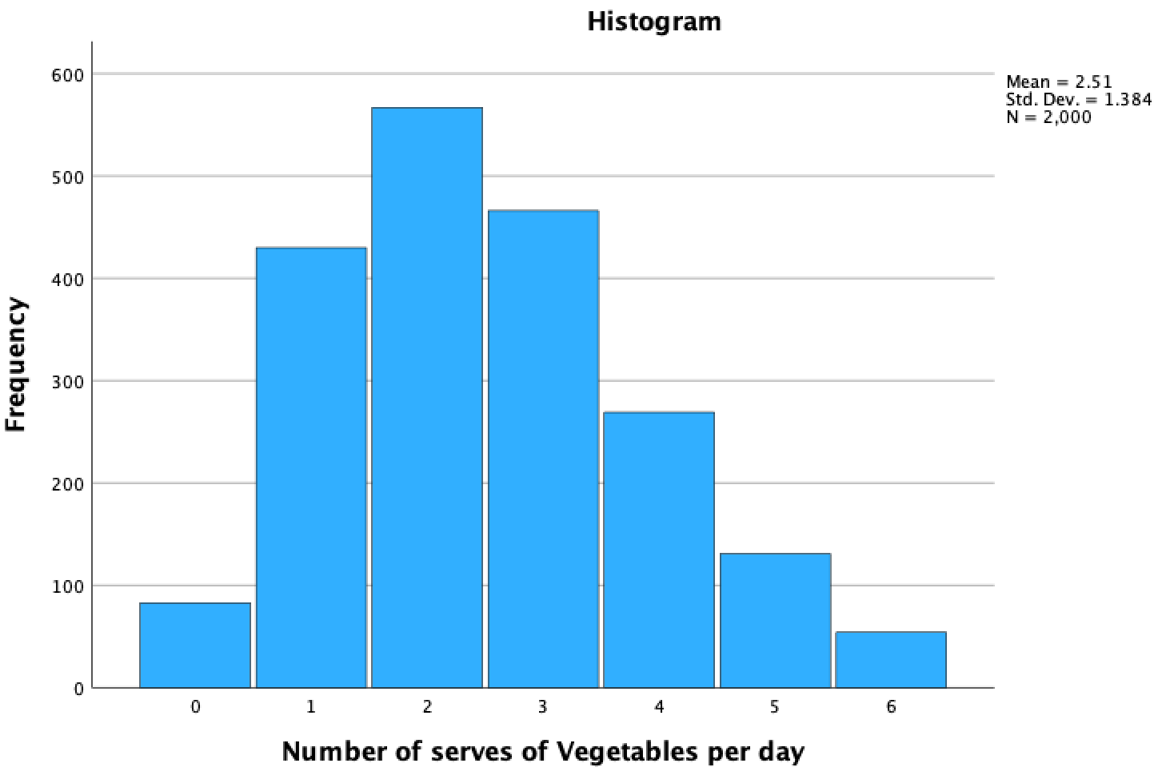
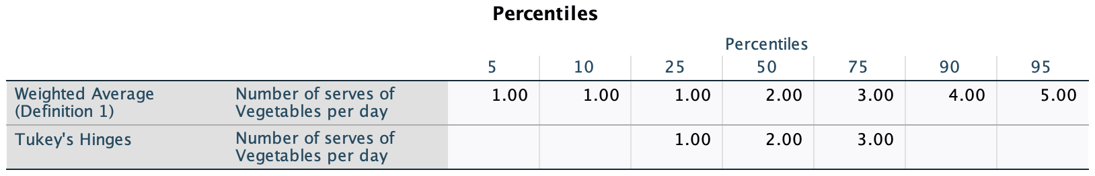
Revision of Week 2
Metric variables:
Descriptive Statistics
Histogram / Box Plot
Percentiles Table
Which procedure? EXPLORE
Notes:
We used the Explore procedure. The SPSS default are for the descriptives table and box plot, and we had to ask for the Percentiles table and a Histogram.
Once we have all of this information, we can make a decision about what we might want to include in our report – and we’ll get to that later … as we need to cover some other ‘stuff’ first! ☺

Slide 8
Learning Outcomes
By the end this week make sure you:
understand the main measures of variability
understand how variability is calculated, interpreted, and graphed
know how to write a report for categorical and metric variables
can produce and interpret output for categorial and metric variables in SPSS
understand how to edit SPSS output and transfer SPSS output into WORD

Slide 9
Features of distributions [metric data]
Central tendency
provides us with a statistic that defines the centre of the distribution [mean / median / mode]
the values that is ‘most typical’ / ‘most representative’ of the entire group
Variability
Measures the degree to which scores are spread out / clustered together
Shape
Symmetric / Skewed [positive / negative]
Extreme Scores [outliers]
Any very high or low values

Slide 10
Variability
Variability
Measuring the amount of variability in a distribution of scores
How different are the scores?
Are the scores spread out or closely clustered together?
Distance between scores
Provides information about the ‘amount of error’ we can expect between a sample and a population
What if everyone was 34 years old?
Mean=34 Standard Dev=0

Slide 11
Variability
Three main measures of variability:
Range
Variance
Standard deviation

Slide 12
Range
Distance covered by the scores:
Range = X_{max} – X_{min}
Largest score minus lowest score
eg: Max score 15, Min score 7
X_{max} – X_{min} = 15 – 7 = Range of 8
NOT a reliable measure of variability
Extreme scores [outliers]
eg: Scores of 1, 16, 18, 19
X_{max} – X_{min} = 19 – 1 = Range of 18
BUT, three of the values are between 16 and 19

Slide 13
Variability
Standard deviation is the most commonly used measure of variability
Uses the mean as a ‘starting point’ / reference point
Measures the variability between each score and the mean
How much each score deviates from the mean
Deviation score = X - µ
Value of interest minus population mean
eg: Test scores: Class mean = 75
Your Score = 70
Deviation = -5 [5 marks below mean]
Your Score = 80
Deviation = 5 [5 marks above mean]

Slide 14
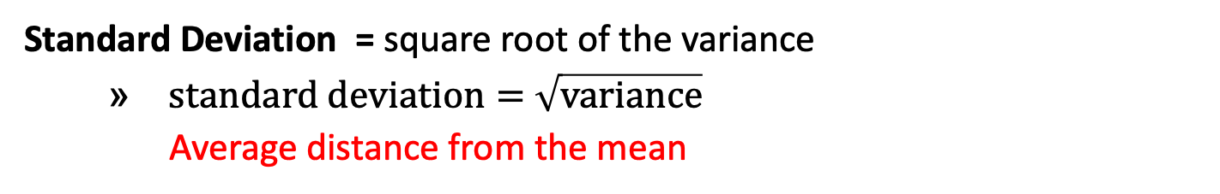
Deviation / Variance / Standard Deviation
Deviation = distance from the mean
Deviation = X - µ
Value of interest minus population mean
Variance = mean of squared deviations
Just adding the deviation scores adds to zero
Average of squared distance from the mean
Definitional calculation / Computational calculation
Standard Deviation = square root of the variance
$standard deviation=$ $\sqrt{variance}$
Average distance from the mean

Slide 15
Calculating Deviation score for populations
Deviation = distance from the mean
Deviation = X - µ [Value of interest minus population mean]
Values: 2, 1, 9, 4
Scores [X] | Deviation X - µ | Deviation Score
2 | 2 - 4 | -2.00
1 | 1 - 4 | -3.00
9 | 9 - 4 | 5.00
4 | 4 - 4 | 0.00
Scores [X] | Deviation X - µ | Deviation Score
2 | 2 - 4
1 | 1 - 4
9 | 9 - 4
4 | 4 - 4
Scores [X] | Deviation X - µ | Deviation Score
2
1
9
4
Total = 16 N = 4 µ = 4
Deviation scores should add to zero, but this does not give us a measure of the variation, so …
We will use the Sum of the Squared Deviations - SS

Slide 16
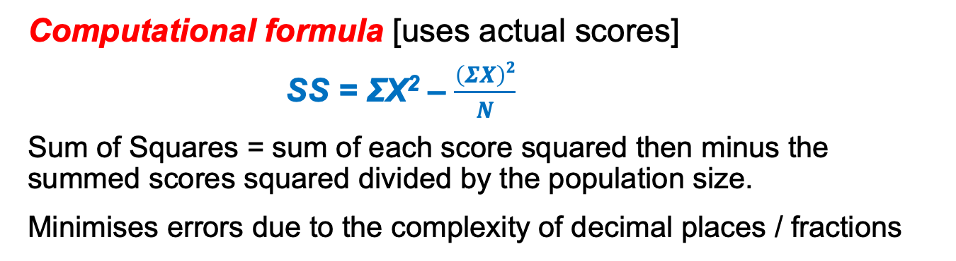
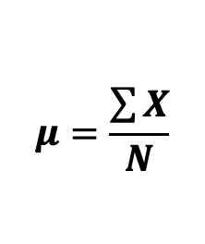
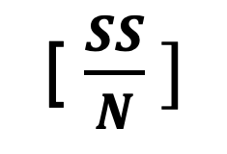
Calculating Variance for populations
Variance = mean of squared deviations
Average of squared distance from the mean
[ $\frac{SS}{N} ]$
$$μ=\frac{\sum{X}}{N}$$
Definitional formula [process using deviation scores]
SS = Σ(X- μ)²
Sum of Squares = Sum of the squared deviation scores
Can be prone to errors [eg rounding if multiple decimal places / fractions]
Computational formula [uses actual scores]
SS = ΣX² – $\frac{\left(ΣX\right)2}{N}$
Sum of Squares = sum of each score squared then minus the summed scores squared divided by the population size.
Minimises errors due to the complexity of decimal places / fractions
Both calculations generally produce the same result.

Slide 17
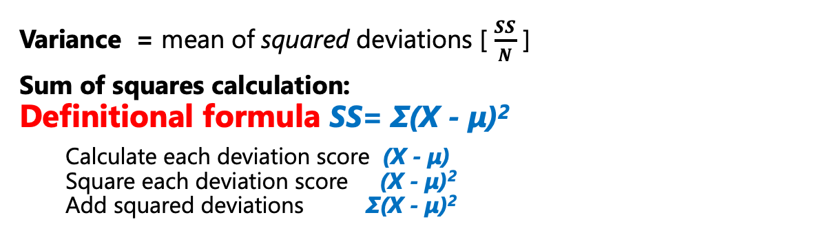
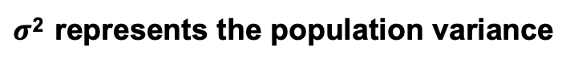
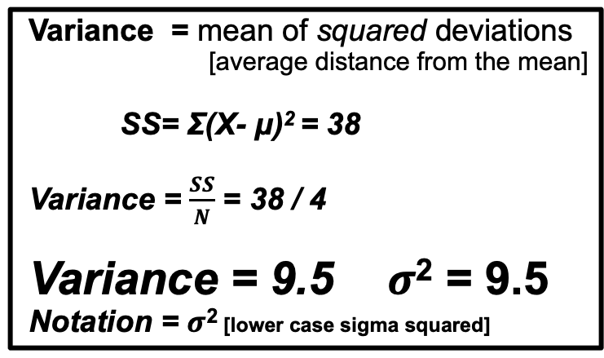
Calculating Variance for populations
Variance = mean of squared deviations [ $\frac{SS}{N}$ ]
Sum of squares calculation:
Definitional formula SS= Σ(X - μ)²
Calculate each deviation score (X - μ)
Square each deviation score (X - μ)²
Add squared deviations Σ(X - μ)²
 | Scores [X] | Deviation X - µ | Squared Deviations (X - µ)²
 | 2
 | 1
 | 9
 | 4
Total | 16
 | Scores [X] | Deviation X - µ | Squared Deviations (X - µ)²
 | 2 | -2
 | 1 | -3
 | 9 | 5
 | 4 | 0
Total | 16 | 0
 | Scores [X] | Deviation X - µ | Squared Deviations (X - µ)²
 | 2 | -2 | 4
 | 1 | -3 | 9
 | 9 | 5 | 25
 | 4 | 0 | 0
Total | 16 | 0 | 38
Variance = mean of squared deviations
[average distance from the mean]
SS= Σ(X- μ)² = 38
Variance = $\frac{SS}{N}$ = 38 / 4
Variance = 9.5 $σ$² = 9.5
Notation = $σ$² [lower case sigma squared]
µ = 4
$σ$² represents the population variance

Slide 18
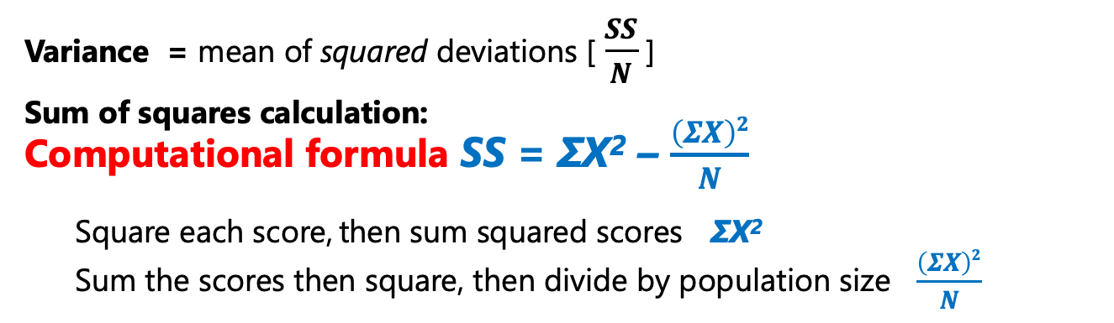
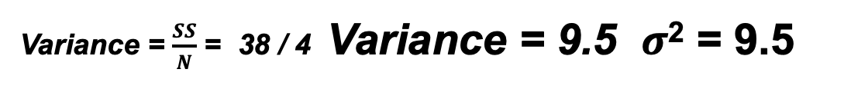
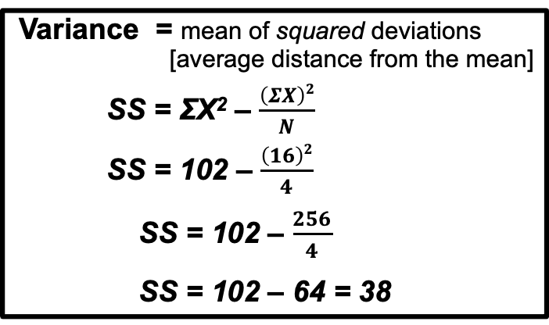
Calculating Variance for populations
Variance = mean of squared deviations [ $\frac{SS}{N}$ ]
Sum of squares calculation: Computational formula SS = ΣX² – $\frac{\left(ΣX\right)2}{N}$
Square each score, then sum squared scores ΣX²
Sum the scores then square, then divide by population size $\frac{\left(ΣX\right)2}{N}$
 | Scores [X] | Squared Scores [X²]
 | 2 | 4
 | 1 | 1
 | 9 | 81
 | 4 | 16
Total | 16 | 102
Variance = mean of squared deviations
[average distance from the mean]
SS = ΣX² – $\frac{\left(ΣX\right)2}{N}$
SS = 102 – $\frac{\left(16\right)2}{4}$
SS = 102 – $\frac{256}{4}$
SS = 102 – 64 = 38
Variance = $\frac{SS}{N}$ = 38 / 4 Variance = 9.5 $σ$² = 9.5

Slide 19
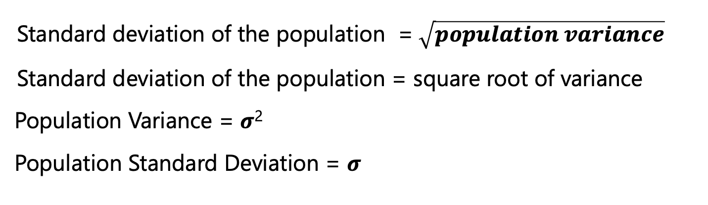
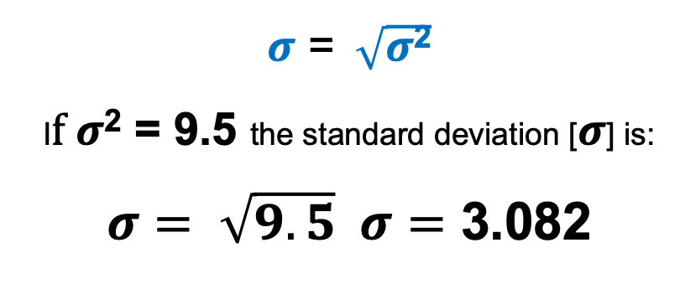
Standard Deviation for populations
Standard deviation of the population =$\sqrt{population variance}$
Standard deviation of the population = square root of variance
$\text{Population} \text{Variance}\text{ = }σ\text{2}$
Population Standard Deviation = $σ$
$σ$ = $\sqrt{σ\text{2}}$
I$f σ$² = 9.5 the standard deviation [$σ$] is:
$σ= \sqrt{9.5} σ=$ 3.082
If everyone in the population has the same score then $σ=$ 0.00

Slide 20
Variance / Standard Deviation for samples
Samples are usually LESS variable than populations
Sample variability gives a biased estimation of the population variability
Sample can overestimate / underestimate population variability
To provide an unbiased estimation of the population variance need to adjust the formula for sample variation / sample standard deviation

Slide 21
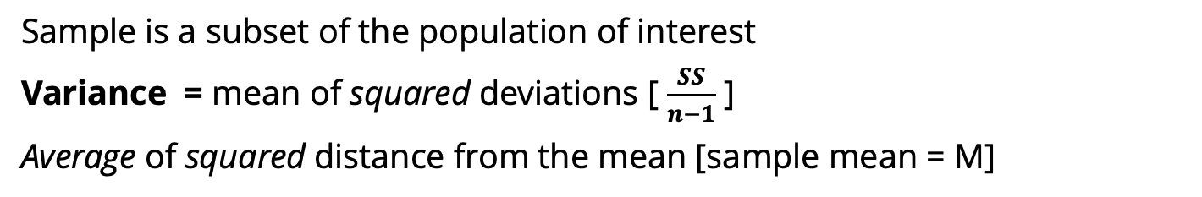
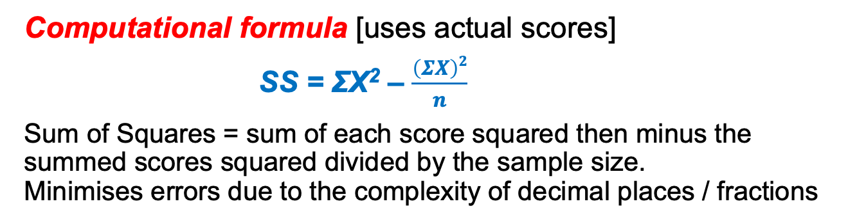
Calculating Variance for samples
Sample is a subset of the population of interest
Variance = mean of squared deviations [ $\frac{SS}{n−1}$ ]
Average of squared distance from the mean [sample mean = M]
Definitional formula [process using deviation scores]
SS = Σ(X - M)²
Sum of Squares = Sum of the squared deviation scores
Can be prone to errors [eg rounding if multiple decimal places / fractions] as was case with populations
Computational formula [uses actual scores]
SS = ΣX² – $\frac{\left(ΣX\right)2}{n}$
Sum of Squares = sum of each score squared then minus the summed scores squared divided by the sample size. Minimises errors due to the complexity of decimal places / fractions
Both calculations generally produce the same result.

Slide 22
Calculating Deviation score for samples
Deviation = distance from the mean
Deviation = X - M [Value of interest minus sample mean]
ID | Number of siblings [X] | Deviation X - M | Deviation Score
1 | 1
2 | 1
3 | 0
4 | 3
5 | 0
6 | 1
7 | 2
8 | 5
9 | 3
10 | 1
11 | 0
12 | 1
ID | Number of siblings [X] | Deviation X - M | Deviation Score
1 | 1 | 1 - 1.5
2 | 1 | 1 - 1.5
3 | 0 | 0 - 1.5
4 | 3 | 3 - 1.5
5 | 0 | 0 - 1.5
6 | 1 | 1 - 1.5
7 | 2 | 2 - 1.5
8 | 5 | 5 - 1.5
9 | 3 | 3 - 1.5
10 | 1 | 1 - 1.5
11 | 0 | 0 - 1.5
12 | 1 | 1 - 1.5
ID | Number of siblings [X] | Deviation X - M | Deviation Score
1 | 1 | 1 - 1.5 | -0.50
2 | 1 | 1 - 1.5 | -0.50
3 | 0 | 0 - 1.5 | -1.50
4 | 3 | 3 - 1.5 | 1.50
5 | 0 | 0 - 1.5 | -1.50
6 | 1 | 1 - 1.5 | -0.50
7 | 2 | 2 - 1.5 | 0.50
8 | 5 | 5 - 1.5 | 3.50
9 | 3 | 3 - 1.5 | 1.50
10 | 1 | 1 - 1.5 | -0.50
11 | 0 | 0 - 1.5 | -1.50
12 | 1 | 1 - 1.5 | -0.50
Total = 18 n = 12
M = 1.5
Deviation scores should add to zero, but this does not give us a measure of the variation, so …
… we calculate SS and then the variance
Siblings.sav

Slide 23
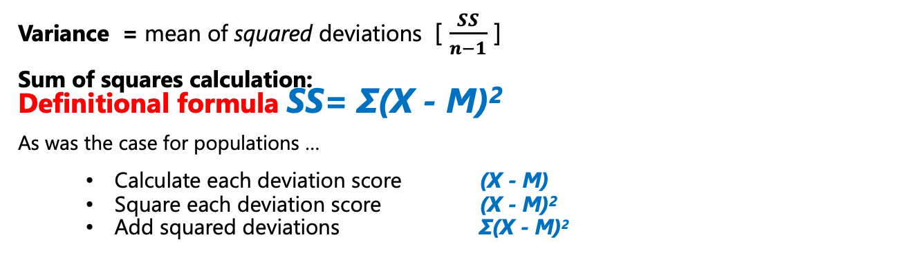
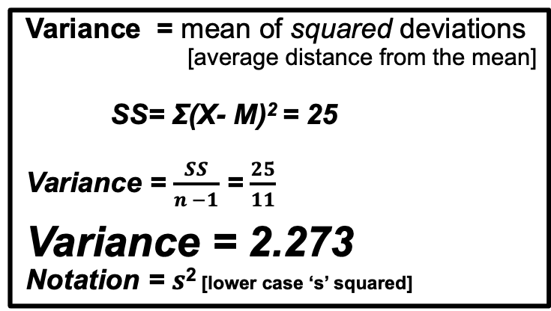
Calculating Variance for samples
Variance = mean of squared deviations [ $\frac{SS}{n−1}$ ]
Sum of squares calculation: Definitional formula SS= Σ(X - M)²
As was the case for populations …
Calculate each deviation score (X - M)
Square each deviation score (X - M)²
Add squared deviations Σ(X - M)²
ID | Scores [siblings] [X] | Deviation X - M | Squared Deviations (X - M)²
1 | 1 | -0.50
2 | 1 | -0.50
3 | 0 | -1.50
4 | 3 | 1.50
5 | 0 | -1.50
6 | 1 | -0.50
7 | 2 | 0.50
8 | 5 | 3.50
9 | 3 | 1.50
10 | 1 | -0.50
11 | 0 | -1.50
12 | 1 | -0.50
Total | 18 | 0
ID | Scores [siblings] [X] | Deviation X - M | Squared Deviations (X - M)²
1 | 1 | -0.50 | 0.25
2 | 1 | -0.50 | 0.25
3 | 0 | -1.50 | 2.25
4 | 3 | 1.50 | 2.25
5 | 0 | -1.50 | 2.25
6 | 1 | -0.50 | 0.25
7 | 2 | 0.50 | 0.25
8 | 5 | 3.50 | 12.25
9 | 3 | 1.50 | 2.25
10 | 1 | -0.50 | 0.25
11 | 0 | -1.50 | 2.25
12 | 1 | -0.50 | 0.25
Total | 18 | 0 | 25.00
Variance = mean of squared deviations
[average distance from the mean]
SS= Σ(X- M)² = 25
Variance = $\frac{SS}{n −1}$ = $\frac{25}{11}$
Variance = 2.273
Notation = $s$² [lower case ‘s’ squared]
s² represents the sample variance

Slide 24
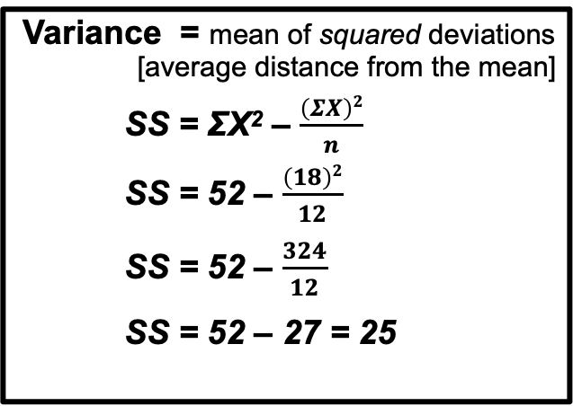
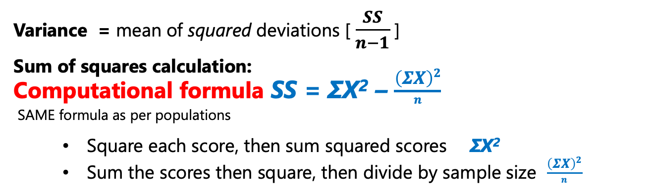
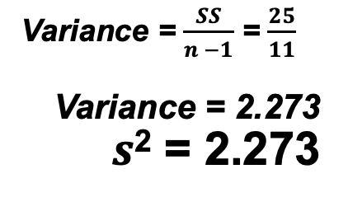
Calculating Variance for samples
Variance = mean of squared deviations [ $\frac{SS}{n−1}$ ]
Sum of squares calculation: Computational formula SS = ΣX² – $\frac{\left(ΣX\right)2}{n}$
SAME formula as per populations
Square each score, then sum squared scores ΣX²
Sum the scores then square, then divide by sample size $\frac{\left(ΣX\right)2}{n}$
ID | Number of siblings [X] | Squared Scores [X²]
1 | 1 | 1
2 | 1 | 1
3 | 0 | 0
4 | 3 | 9
5 | 0 | 0
6 | 1 | 1
7 | 2 | 4
8 | 5 | 25
9 | 3 | 9
10 | 1 | 1
11 | 0 | 0
12 | 1 | 1
Total | 18 | 52
Variance = mean of squared deviations
[average distance from the mean]
SS = ΣX² – $\frac{\left(ΣX\right)2}{n}$
SS = 52 – $\frac{\left(18\right)2}{12}$
SS = 52 – $\frac{324}{12}$
SS = 52 – 27 = 25
Variance = $\frac{SS}{n −1}$ = $\frac{25}{11}$
Variance = 2.273
$s$² = 2.273

Slide 25
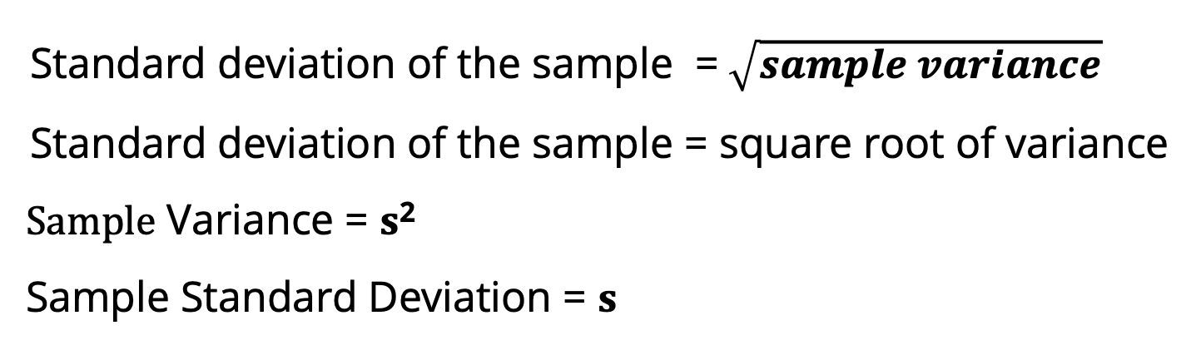
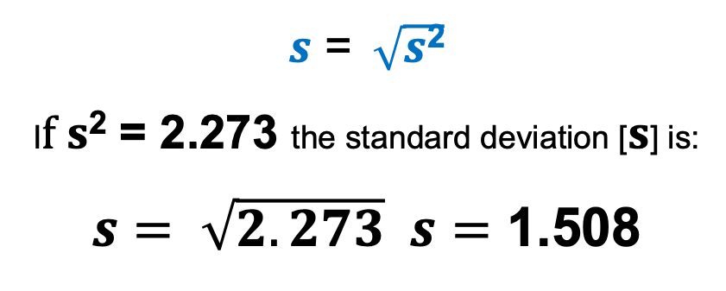
Standard Deviation for samples
Standard deviation of the sample =$\sqrt{sample variance}$
Standard deviation of the sample = square root of variance
$\text{S}\text{ample} \text{Variance}\text{ = }s\text{2}$
Sample Standard Deviation = $s$
$s$ = $\sqrt{s\text{2}}$
I$f s$² = 2.273 the standard deviation [$s$] is:
$s= \sqrt{2.273} s=$ 1.508
If everyone in the sample has the same score then $s=$ 0.00

Slide 26
Variance and Standard Deviation of Siblings sample [SPSS]
SPSS – EXPLORE procedure
Descriptives
 |  |  | Statistic | Std. Error
Number of Siblings | Mean |  | 1.50 | .435
 | 95% Confidence Interval for Mean | Lower Bound | .54
 |  | Upper Bound | 2.46
 | 5% Trimmed Mean |  | 1.39
 | Median |  | 1.00
 | Variance |  | 2.273
 | Std. Deviation |  | 1.508
 | Minimum |  | 0
 | Maximum |  | 5
 | Range |  | 5
 | Interquartile Range |  | 3
 | Skewness |  | 1.242 | .637
 | Kurtosis |  | 1.328 | 1.232

Slide 27

Uni April 4 2020

Slide 28
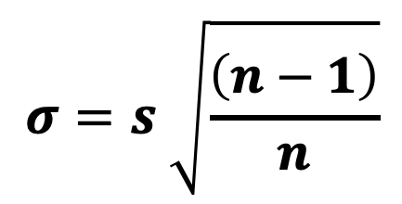
Cautionary Note - SPSS
SPSS cannot differentiate between a sample and a population
SPSS calculates the variance and standard deviation based on ‘n – 1’ adjustment
Calculations for samples
IF scores are actually populations, the sample standard deviation can be adjusted to obtain the population standard deviation
$$σ=s \sqrt{\frac{\left(n−1\right)}{n}}$$

Slide 29
Why n – 1 for sample calculations?
Each sample we take may have a different mean than the population. Variance tells us how varied these samples might be, but we know that the values will cluster around the mean
To compensate for samples being less variable than the population, we use n – 1 in our sample calculations
This brings in the concept of degrees of freedom [df] …
The degrees of freedom determine the number of scores that are ‘free to vary’
For n scores, n-1 scores are free to vary, the remaining score is ‘fixed’

Slide 30
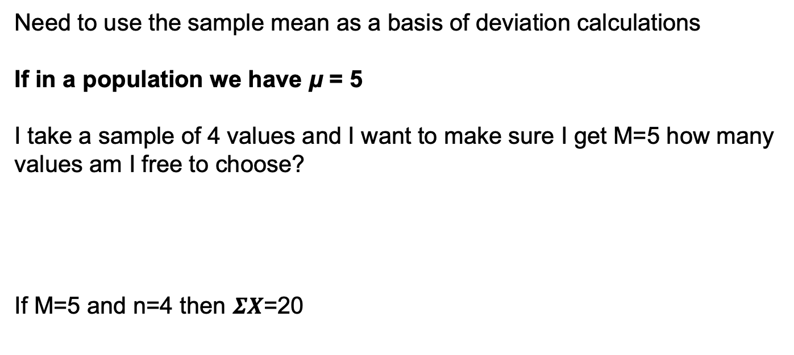
Why n – 1 for sample calculations?
Need to use the sample mean as a basis of deviation calculations
If in a population we have μ = 5
I take a sample of 4 values and I want to make sure I get M=5 how many values am I free to choose?
If M=5 and n=4 then $ΣX$=20
3
7
2
8
With a sample size of 4 values, 3 were ‘free to vary’.
df = n -1 df = 4 -1 df = 3

Slide 31
Graphing variability
Normal Distribution:
68 – 95 – 99.7% Rule [Rule of Thumb]
One standard deviation either side of the mean captures approx 68% of our data
Two standard deviations either side of the mean captures approx 95% of our data
Three standard deviations either side of the mean captures approx 99.7% of our data

Slide 32
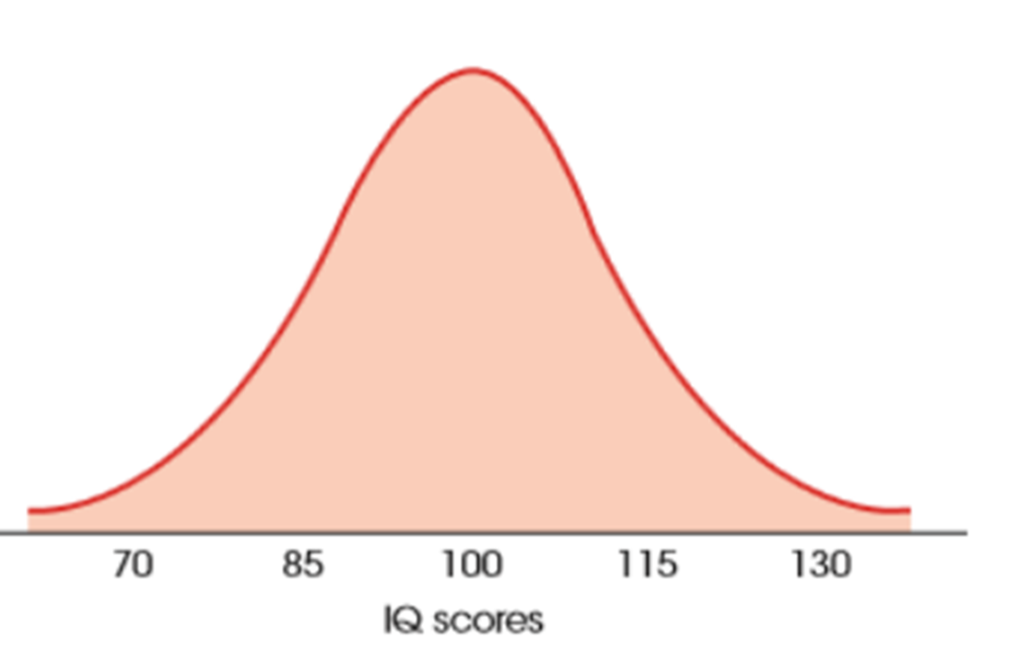
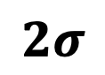
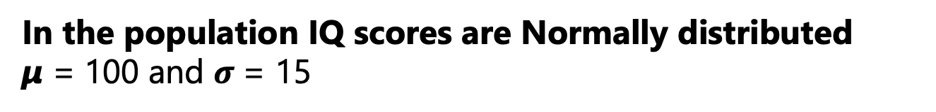
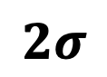
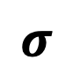
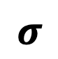
Graphing variability
In the population IQ scores are Normally distributed
µ = 100 and $σ$= 15
2.5%
95%
2.5%
$$2σ$$
$$2σ$$
68%
$$σ$$
$$σ$$

Slide 33
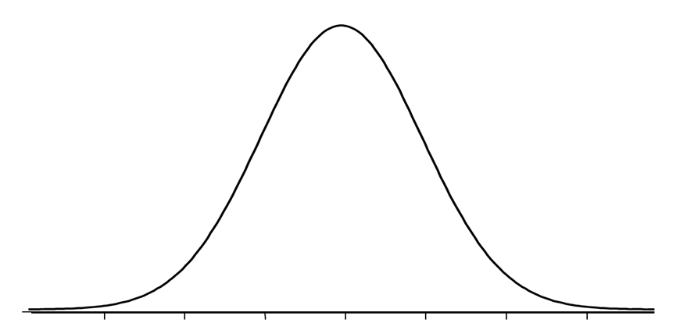
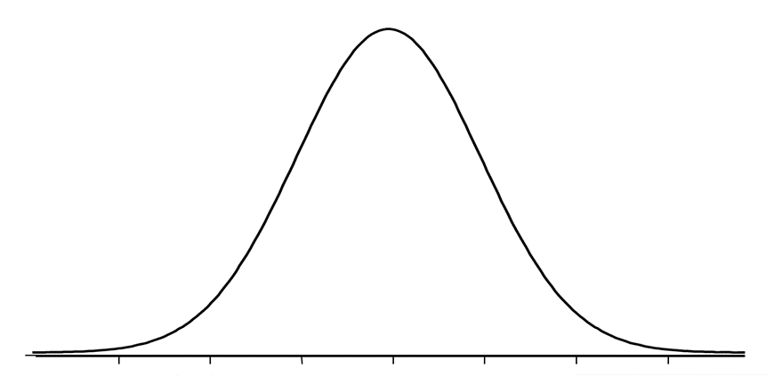
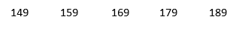
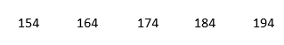
Additional information about variance and standard deviations …
Changing scores:
Note that adding a constant [same] score to each value does NOT change the standard deviation
Just moves the distribution
The standard deviation remains the same, although the mean would change by the constant
eg adding one constant to each of the data values adds one value to the mean
But since the variability is calculated based on deviations of scores [(X - µ) or (X – M)] , the variability remains the same
If we added 5cm to each persons height, the mean would increase by 5
The standard deviation would remain at the value calculated

Slide 34
Additional information about variance and standard deviations …
Multiplying scores:
Multiplying each score by a constant DOES change the standard deviation
Changes by the same multiplier
Mean = 40 and standard deviation = 10
Suppose we have values of:
X = 41 and X = 43 [distance between scores = 2]
If we multiplied each score by 2
X = 82 and X = 86 [distance between scores = 4]

Slide 35
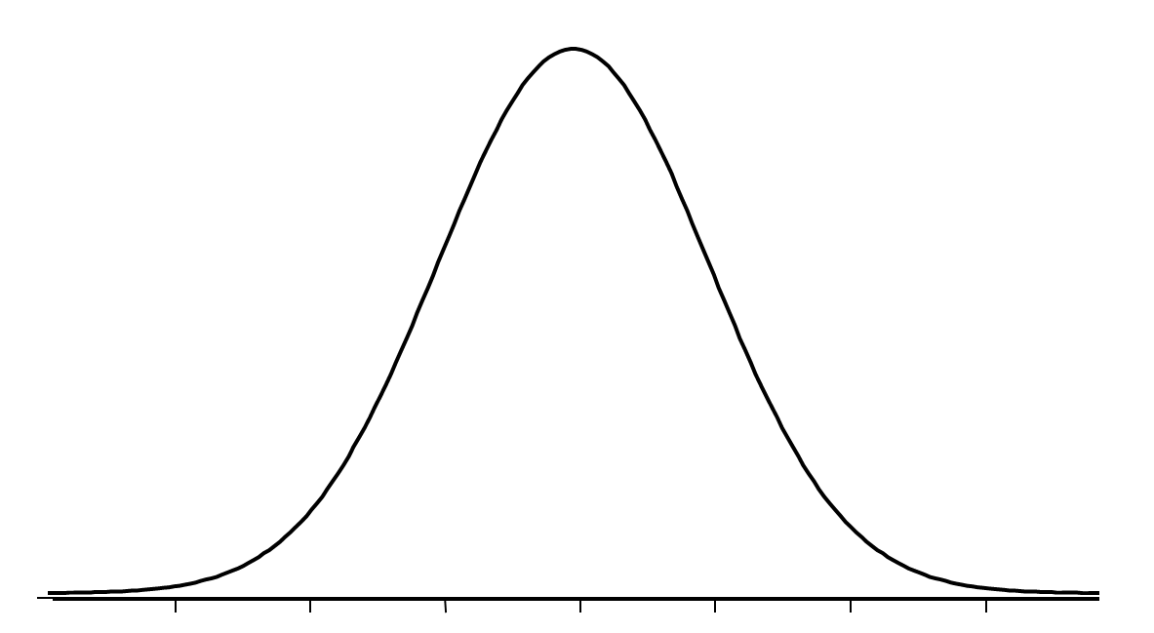
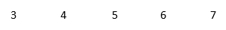
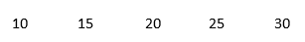
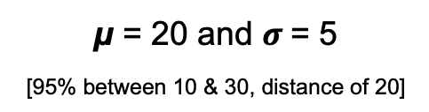
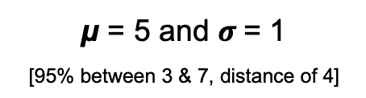
Additional information about variance and standard deviations …
Mean and standard deviation together:
Whenever we use the mean as our measure of centre, the standard deviation should be shown
Allows fuller description of the overall ‘picture’ of the distribution [spread of data]
µ = 5 and $σ$= 1
[95% between 3 & 7, distance of 4]
µ = 20 and $σ$= 5
[95% between 10 & 30, distance of 20]

Slide 36
Additional information about variance and standard deviations …
Distribution of height [cm]:
Mean = 169 / Standard Deviation = 10
-
-
-
149 159 169 179 189
-2 sd -1sd Mean +1sd +2sd
159
179
68% of data falls between ___ and ___ cm
95% of data falls between ___ and ___ cm
149
189
For this distribution heights less than 149 and more than 189 are unusual
Notes:
Again using our hours of TV watched per day example, with an average of 4 hours and a standard deviation of 1.5, we can use our 68-95-99.7% rule to interpret our findings.
In this example, 68% of our values lie between 2.5 and 5.5 hours.
95% lie between 1 and 7 hours.
As well as being able to draw the distribution and put in figures, we can use the z-score – the standardised value – to calculate how far from the mean a particular value lays ...

Slide 37
Part 2: Reporting on a Distribution
PAUSE

Slide 38
Part 2: Reporting on a Distribution
STA10003 Week 3

Slide 39
Reporting on a distribution
Categorical:
Information about variable
Sample Size
Sample - Who / What
What did we find out? [most typical? / mode]
Anything else of interest?
Notes:
When we’re writing a report on the distribution of a Categorical variable, we need to think about what information might be useful.
We need to remember that we are INTERPRETING our findings, not just pulling out figures to quote.
We would always talk about our population, and include the size of our sample.
We would then report information about our sample. What did we find out – what was our most typical response – our mode?
Was there anything else interesting? ...

Slide 40
Reporting on a distribution - Categorical
‘Most common use of wearable technology’ variable from tutorial survey:
Sample size
Most typical and any other interesting information
Include labelled figure
Most COMMON use of wearable technology
 |  | Frequency | Percent | Valid Percent | Cumulative Percent
Valid | Step Counter | 36 | 15.1 | 55.4 | 55.4
 | Heart Rate | 8 | 3.4 | 12.3 | 67.7
 | Active Minutes | 11 | 4.6 | 16.9 | 84.6
 | Other | 10 | 4.2 | 15.4 | 100.0
 | Total | 65 | 27.3 | 100.0
Missing | System | 173 | 72.7
Total |  | 238 | 100.0
Notes:
This variable has four codes. So we need to decide if we want to include all of the categories – or just the main ones.
We need to think about our Population – in this data set we have sampled Australian adults, so our population is … ALL Australian adults.
Sample size? [How many people answered the question?} – 442 – so our sample size is 442.
What was the most typical response? Australian born
And it’s value? – 64.7% [remember that we’re using the Valid Percent column to get our percentage based on those who answered the question].
This gives us the basis for the report. We should then add a labelled bar chart ...

Slide 41
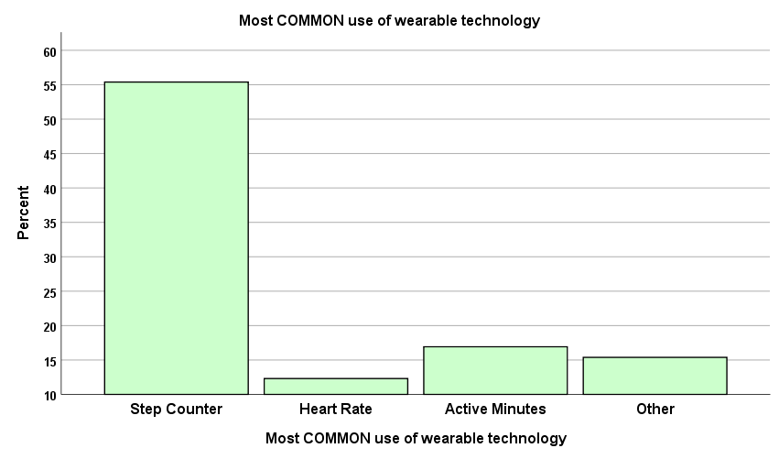
Reporting on a distribution - Categorical
The distribution of ‘most common use of wearable technology’ is shown in Figure 1. In this sample of 65 STA10003 students, 55.4% reported that they check their step counter first. A similar percentage of students checked either their active minutes [16.9%], or ‘other’ activities [15.4%]. The remaining students suggested they checked their heart rate in the first instance [12.3%].
Figure 1: Distribution of most common use of ‘wearable’ technology
Notes:
Based on the decision we made about what figures to include, this report is quite small overall.
Our first sentence includes a reference to our variable and our graph.
The next couple of sentences tells us what we found in our sample. You’ll notice that I have included the data value labels in the histogram as well. This is so that anyone reading the report can see the breakdown of percentages for the ‘born elsewhere’ people. The figure is provide to supplement the information in the report, so although we talked about the Southern European born and those born in other regions in the ‘born elsewhere’ category, the reader can get additional information from the bar chart.
So the report is concise – to the point.
But we’d really like to know something about ALL Australian adults, and not just our sample. So what percentage of Australians in the population are actually Australian born? …

Slide 42
Reporting on a distribution - Metric
Metric: [include labelled histogram]
Shape
Approximately symmetric
Positively Skewed
Negatively Skewed
Centre
Symmetric with no outliers – mean and include standard deviation
Skewed or Symmetric with outliers – median
Spread
‘Typical’ – Middle 50% [IQR] from Percentiles table
Use 25th and 75th percentiles
Outliers
Any values extremely high / low? State figures and direction
Notes:
But, when we have Metric data, we have more information to choose from, and the figures that we interpret will depend on the shape of the distribution, and whether or not we have any outliers – that is, extremely high or low values.
When reporting on a metric distribution, we talk about Shape, Centre and Spread – and also mention outliers if they exist.
Is the shape of our distribution approximately symmetric, or skewed – and in which direction?
If it’s symmetric we’d use the mean as our measure of centre, and include the sd as well. With skewed data we’d use the median.
The middle 50% - from our percentiles table – gives us a good indication of what’s typical. We talked last week about how we can use the Percentiles table to provide with a lot more information about what our sample is telling us.
Mentioning any outliers also adds to the description ...

Slide 43
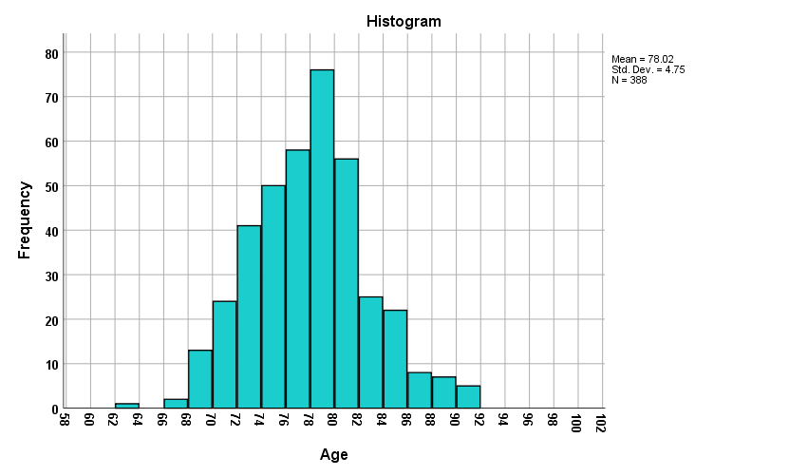
Reporting on a distribution - Metric
Life expectancy of males in Australia?
Descriptives
 |  |  | Statistic | Std. Error
Age | Mean |  | 78.02 | .241
 | 95% Confidence Interval for Mean | Lower Bound | 77.55
 |  | Upper Bound | 78.49
 | 5% Trimmed Mean |  | 77.94
 | Median |  | 78.04
 | Variance |  | 22.561
 | Std. Deviation |  | 4.750
Percentiles
 |  | Percentiles
 |  | 5 | 10 | 25 | 50 | 75 | 90 | 95
Weighted Average (Definition 1) | Age | 70.43 | 71.91 | 74.56 | 78.04 | 80.91 | 84.28 | 86.18
Tukey's Hinges | Age |  |  | 74.57 | 78.04 | 80.91
Life_Expectancy_MALES_2015.sav
Notes:
Here we’ve used the What_Analysis.sav data file, this time looking at Travel time to work in minutes.
This distribution is symmetric, so we’ll use the mean, standard deviation, and the middle 50% to form the basis of our description.
I’ve also highlighted the 95% Confidence Interval. As I mentioned, SPSS produces this for Metric data ...

Slide 44
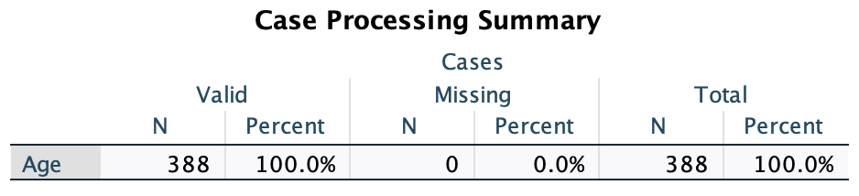
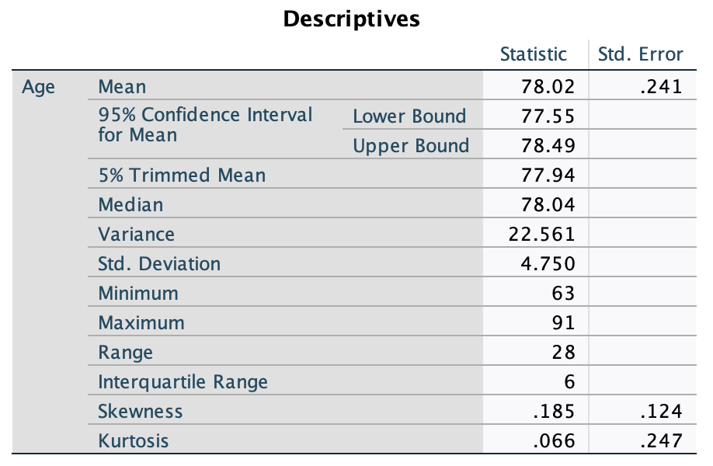
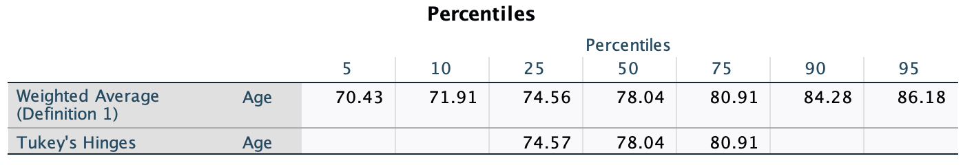
Reporting on a distribution - Metric
Life expectancy of males in Australia
Life_Expectancy_MALES_2015.sav
Notes:
Here we’ve used the What_Analysis.sav data file, this time looking at Travel time to work in minutes.
This distribution is symmetric, so we’ll use the mean, standard deviation, and the middle 50% to form the basis of our description.
I’ve also highlighted the 95% Confidence Interval. As I mentioned, SPSS produces this for Metric data ...

Slide 45
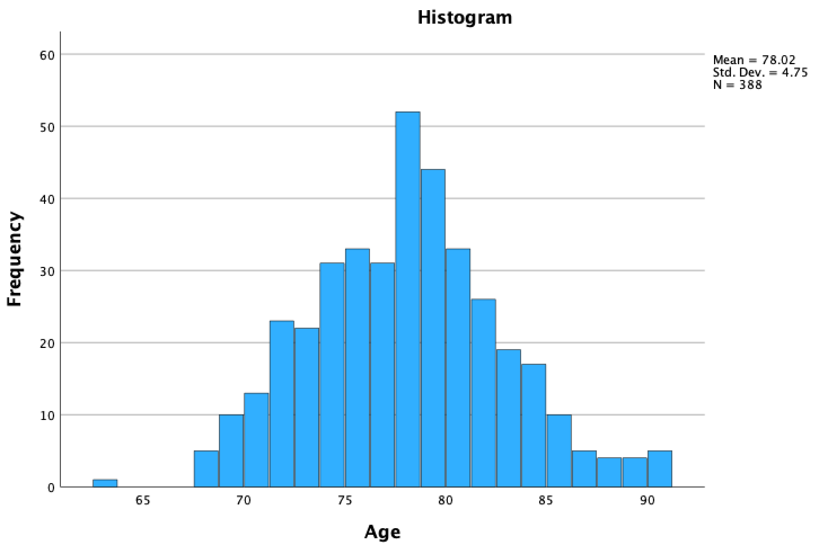
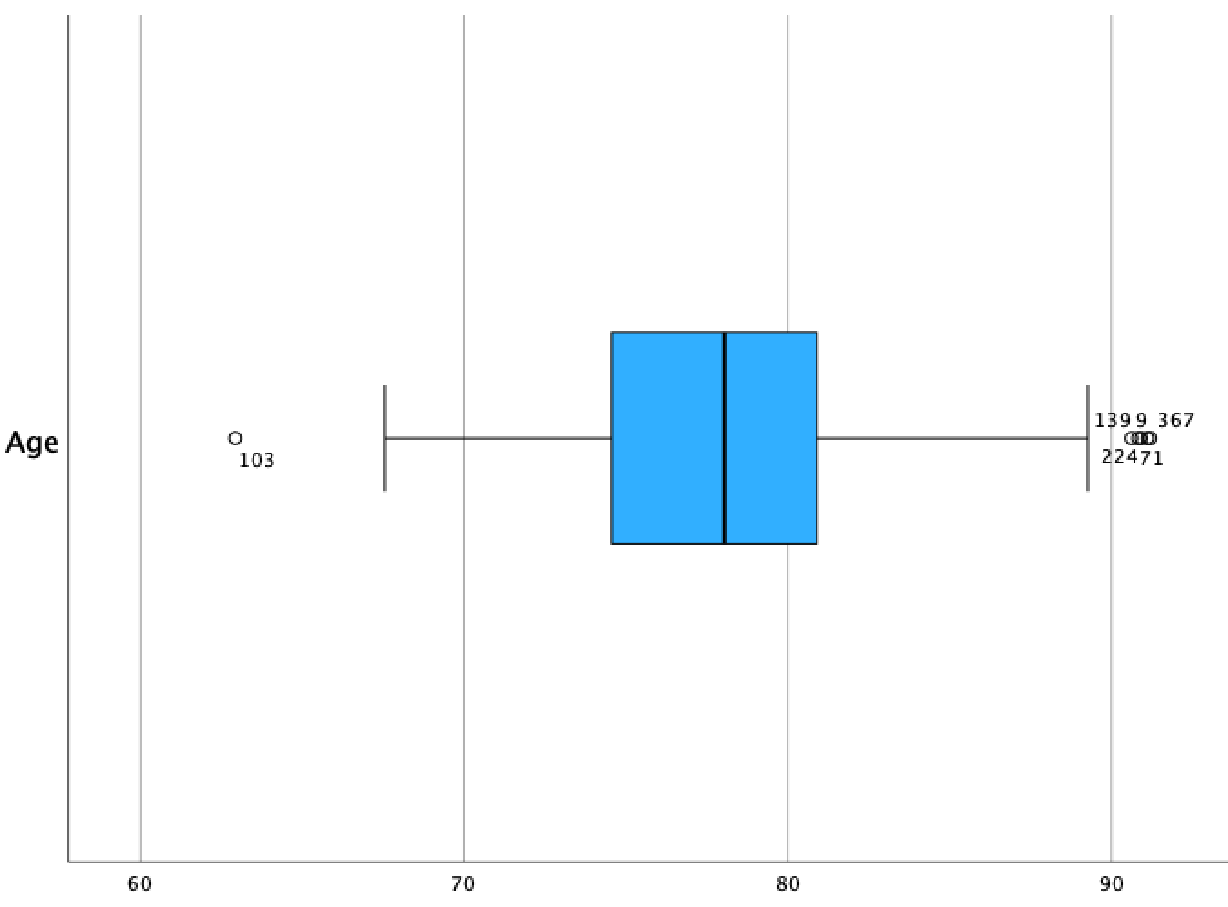
Reporting on a distribution - Metric
Life expectancy of males in Australia
Life_Expectancy_MALES_2015.sav
Notes:
Here we’ve used the What_Analysis.sav data file, this time looking at Travel time to work in minutes.
This distribution is symmetric, so we’ll use the mean, standard deviation, and the middle 50% to form the basis of our description.
I’ve also highlighted the 95% Confidence Interval. As I mentioned, SPSS produces this for Metric data ...

Slide 46
Reporting on a distribution - Metric
Life expectancy of males in Australia?
Shape: Approximately Symmetric
Centre: M = 78.02 years / s = 4.75 years
Spread: ‘Typically’ – Middle 50%:
74.56 – 80.91 years [from percentiles table]
Outliers: None [no need to mention this]
Graph: Histogram
Notes:
Thinking about our shape, centre, and spread – we can now work out what we might put in the report.
You might notice that I’ve rounded these figure – mainly so I don’t have to work out what .98 of a minute is!
Go through slide.
Remind students that if there were any outliers, the shape would NOT be approximately symmetric! ...

Slide 47
Reporting on a distribution - Metric
Our report - [shape / centre / spread / outliers]
The distribution of Life Expectancy in years for a random sample of 388 Australian males is displayed in Figure 2. The distribution is approximately symmetric, and the average life expectancy was 78.02 years (s = 4.75 years). Typically, age at time of death was between 74.56 and 80.91 years, with half of the life expectancy values falling within this range.
Figure 2: Distribution of male life expectancy [in years]
Notes:
Our report would look like this.
I’ve bolded some of the important wording. [ie the shape, centre, spread, 95% CI].
But what happens if our distribution is skewed? ...

Slide 48
Reporting on a distribution - Metric
Our report - [shape / centre / spread / outliers]
The distribution of Life Expectancy in years for a random sample of 388 Australian males is displayed in Figure 2. The distribution is approximately symmetric, and the average life expectancy was 78 years (s = 5 years). Typically, age at time of death was between 75 and 81 years, with half of the life expectancy values falling within this range.
Figure 2: Distribution of male life expectancy [in years]
Notes:
Our report would look like this.
I’ve bolded some of the important wording. [ie the shape, centre, spread, 95% CI].
But what happens if our distribution is skewed? ...

Slide 49
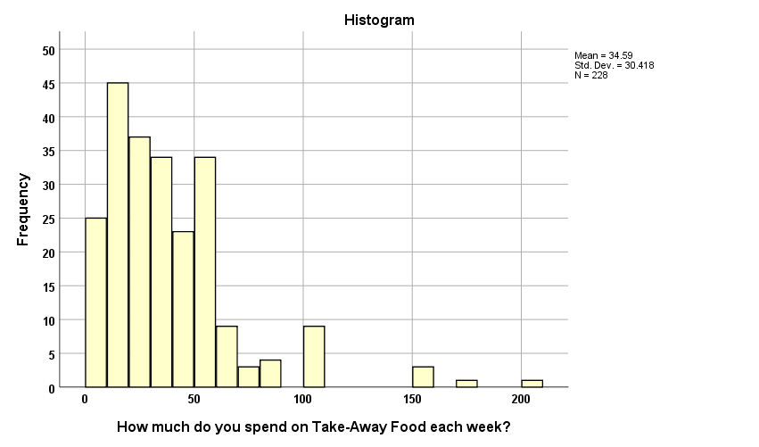
Reporting on a distribution - Metric
Amount spent on Take-Away Food per week
Descriptives
 |  |  | Statistic | Std. Error
How much do you spend on Take-Away Food each week? | Mean |  | 34.5877 | 2.01448
 | 95% Confidence Interval for Mean | Lower Bound | 30.6182
 |  | Upper Bound | 38.5572
 | 5% Trimmed Mean |  | 31.2914
 | Median |  | 30.0000
 | Variance |  | 925.257
 | Std. Deviation |  | 30.41803
 | Minimum |  | .00
 | Maximum |  | 200.00
 | Range |  | 200.00
30
Percentiles
 |  | Percentiles
 |  | 5 | 10 | 25 | 50 | 75 | 90 | 95
Weighted Average (Definition 1) | How much do you spend on Take-Away Food each week? | .00 | 5.00 | 15.00 | 30.00 | 50.00 | 60.00 | 100.00
Tukey's Hinges | How much do you spend on Take-Away Food each week? |  |  | 15.00 | 30.00 | 50.00
Notes:
Here I’ve used some data provided by a colleague who asked Victorian High School Students how long they spend of Facebook per day. Note that I have ‘cut’ some of the descriptives so that it fits on the page.
You can see that the distribution is skewed – in which direction? - positively skewed.
There’s also a ‘blip’ around the 360 minute mark. This might be clearer on the box plot, but because we will be using the histogram as our graphical representation I’ve included it here. Besides, I couldn’t fit the box plot on the slide as well.
So we’ll need to use the median as our measure of centre, the middle 50% as our spread, and think about how to report the outliers ...

Slide 50
Reporting on a distribution - Metric
Take-Away Food spend:
Shape: Positively skewed
Centre: Median = $30.00
Spread: ‘Typically’ – Middle 50% $15.00 - $50.00
Outliers: $100 or more up to $200.00 per week [extremely high]
Graph: Histogram
Notes:
Go through slide …

Slide 51
Reporting on a distribution - Metric
Our report - [shape / centre / spread / outliers]
The distribution of amount spent on Take-Away food per week for this sample of 228 STA10003 students is displayed in Figure 3. The distribution is positively skewed with 50% of Take-Away food spend per week being $30.00 or more. Typically, Take-Away food spend was between $15.00 and $50.00 per week with half of the Take-Away food spend amounts falling within this range. Some students spent an unusually high amount on Take-Away food per week. These students spent between $100.00 and $200.00 per week.
Figure 3: Distribution of amount spent on Take-Away food per week
Notes:
As with our report of travel times to work, we start with a ‘setting the scene’ sentence – and again I’ve highlighted some of the important wording.
Work through slide. Note that I have rounded when talking about the minutes per day on Facebook.
We’ve now been able to describe distributions for Categorical and Metric variables, including the 95% Confidence Interval – where appropriate.
And here’s a brief summary ...

Slide 52
Describing distributions of single variables
What is the level of measurement of the variable?
Categorical
Metric
Graphical Display
Bar Chart
or Pie Chart
(2-3 categories)
Histogram
or Box plot
Skewed or with outliers
Symmetric
Summary Statistics
Mode
Median
Mean

Slide 53
Reading B: Reporting Information about Single Variables
Reading C: Choosing the Correct Analysis

Slide 54
Now What?
Learning Outcomes
Each week there will be intended Learning Outcomes. By the end this week make sure you:
understand the main measures of variability
understand how variability is calculated, interpreted, and graphed
know how to write a report for categorical and metric variables
can produce and interpret output for categorial and metric variables in SPSS
understand how to edit SPSS output and transfer SPSS output into WORD
Attend the Weekly Tutorial

Slide 55
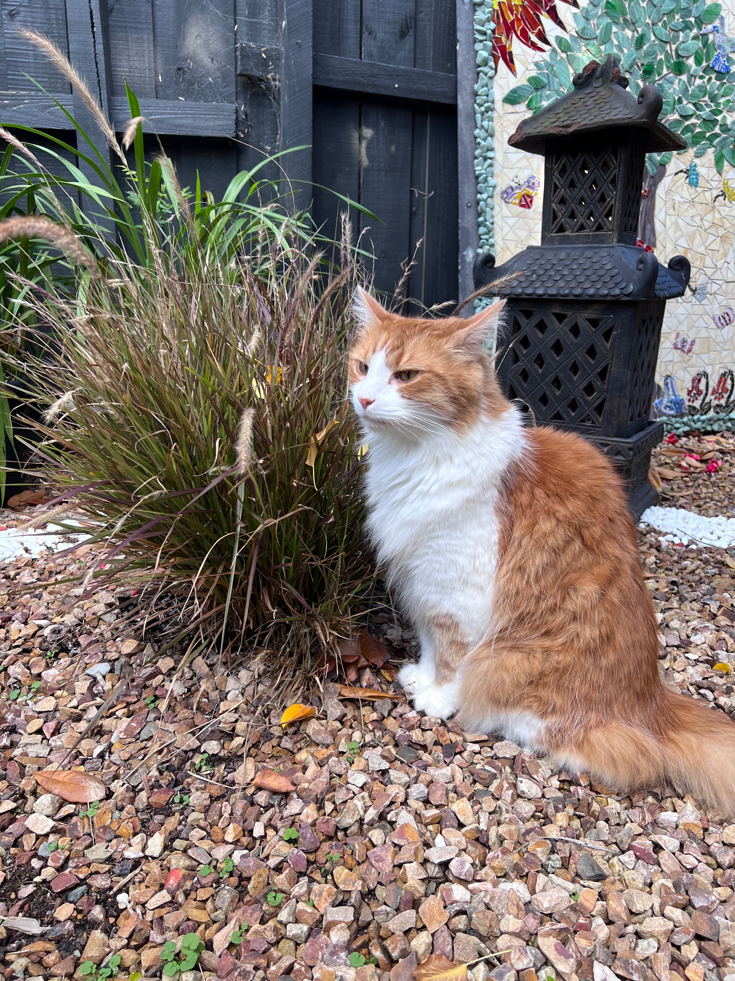
Fa June 10 2022

